Slide 1


Websites Platforms for Hong Kong
Career Coaching Center-CCC

Slide 2
WEBSITES PLATFORMS
JobsDB Hong Kong (www.jobsdb.com/hk)
Indeed Hong Kong (www.indeed.hk)
CTgoodjobs (www.ctgoodjobs.hk)
Monster Hong Kong (www.monster.com.hk)
JobMarket (www.jobmarket.com.hk)

Slide 3
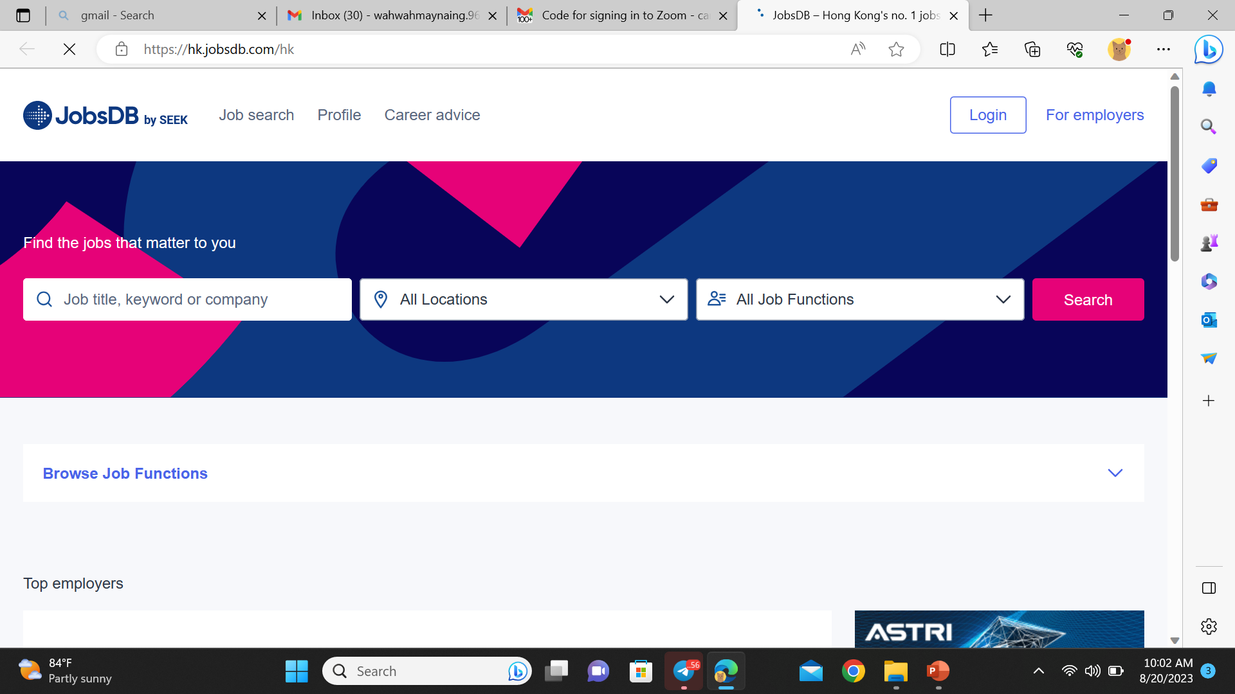
JobsDB Hong Kong (www.jobsdb.com/hk)

Slide 4
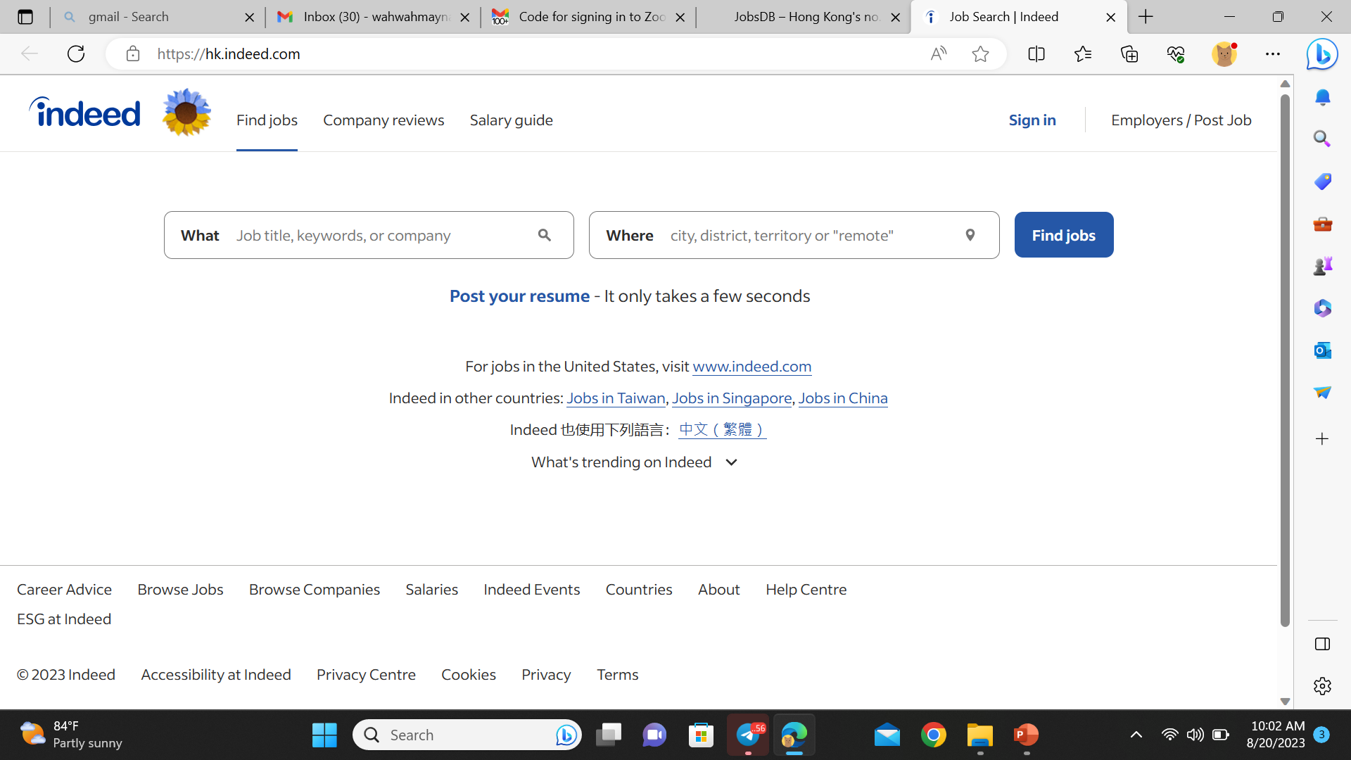
Indeed Hong Kong (www.indeed.hk)

Slide 5
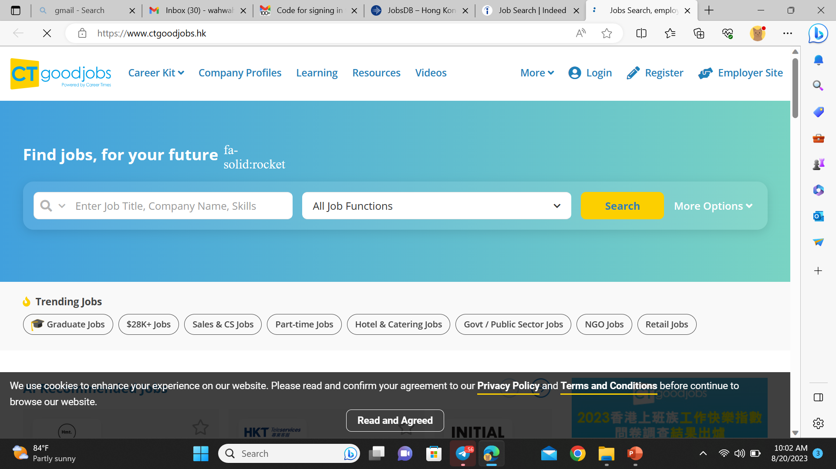
CTgoodjobs (www.ctgoodjobs.hk)

Slide 6
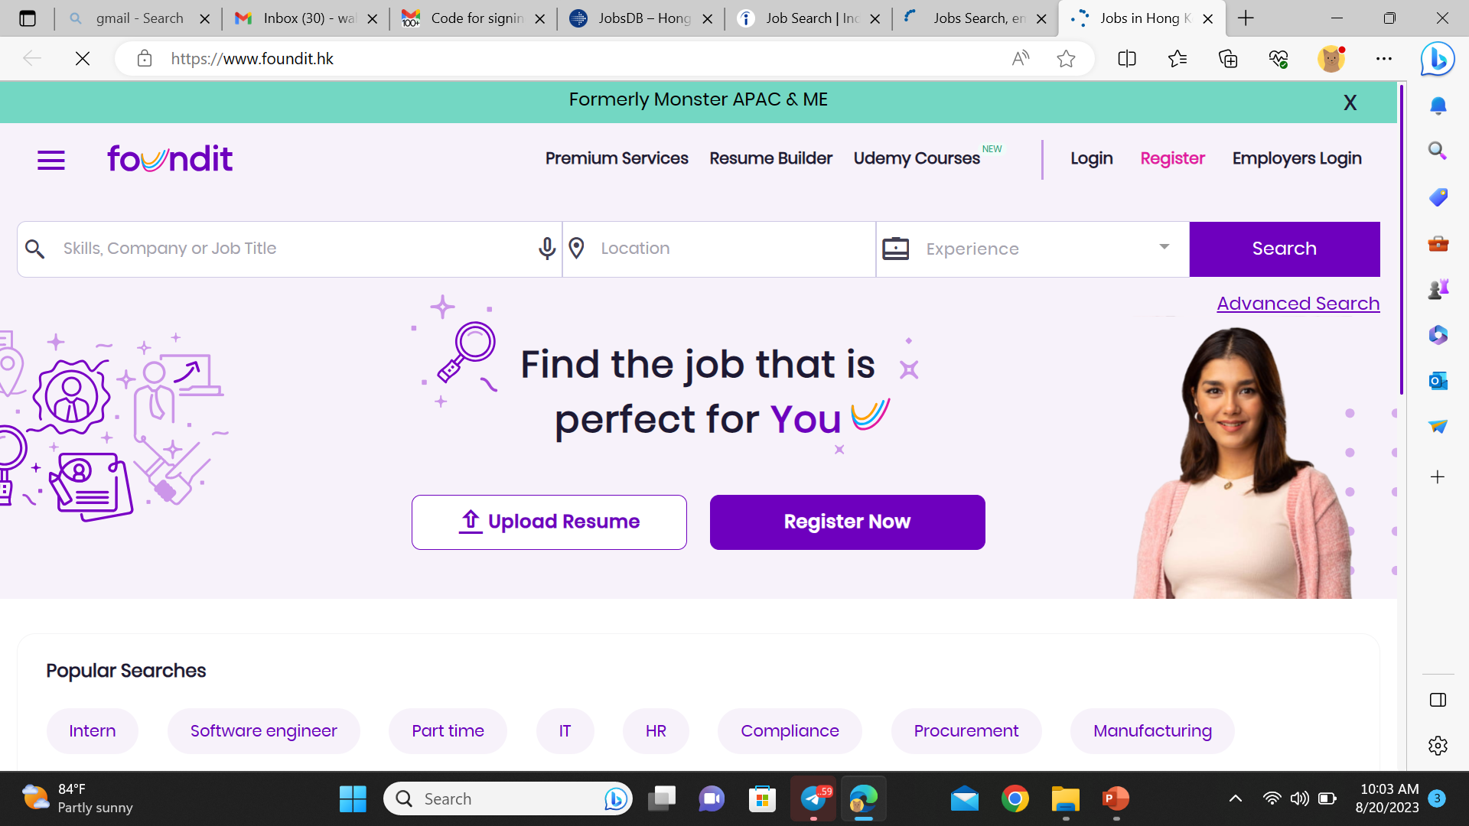
Monster Hong Kong (www.monster.com.hk)

Slide 7
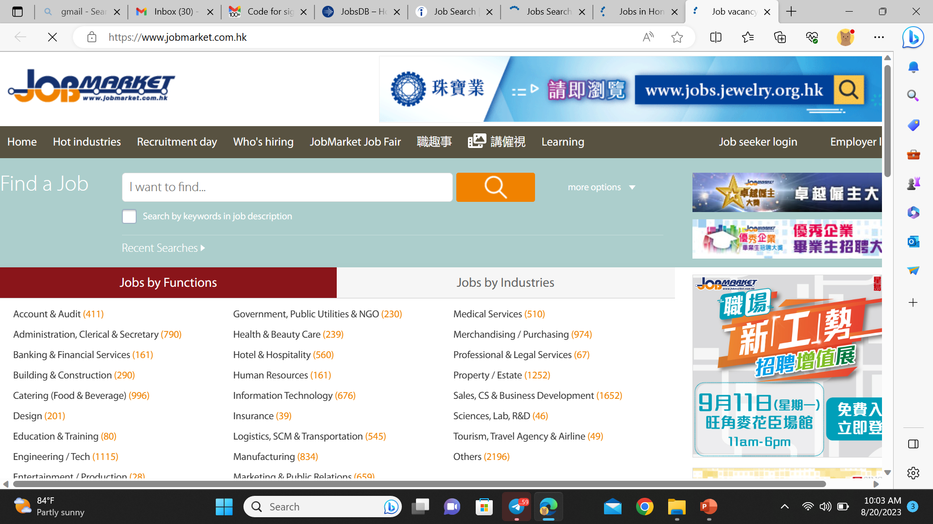
JobMarket (www.jobmarket.com.hk)

Slide 8
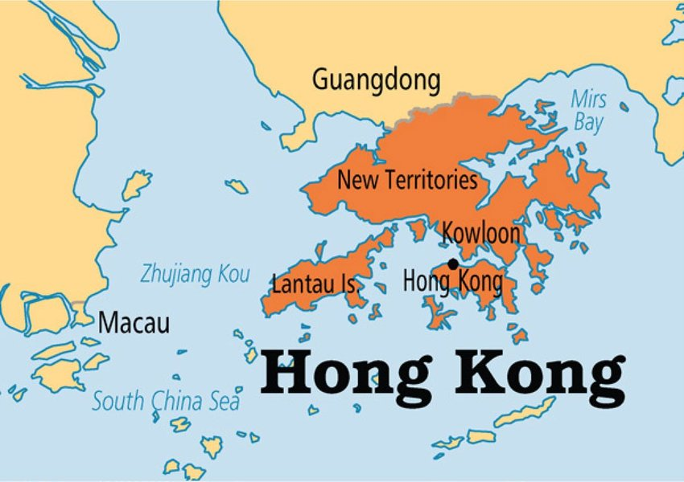
Hong Kong Geography
1,108 sq km

Slide 9

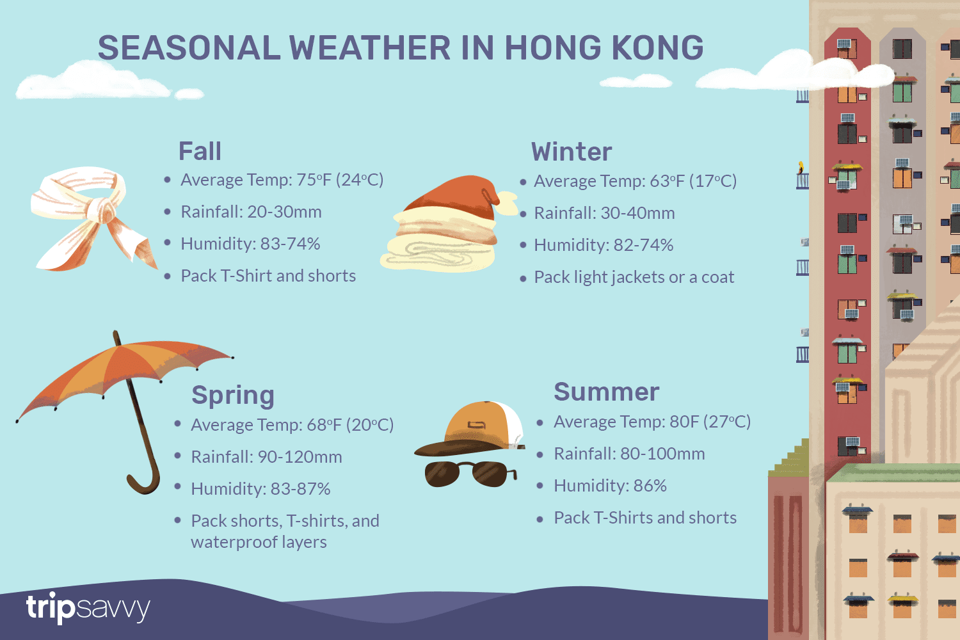
Hong Kong Climate

Slide 10
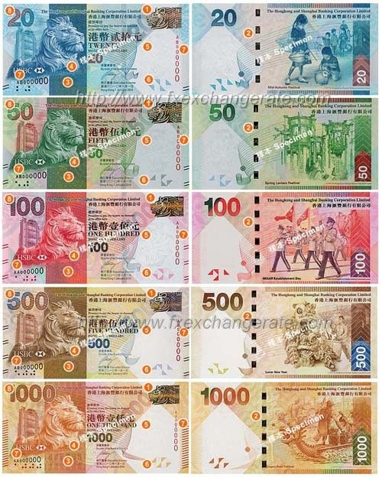
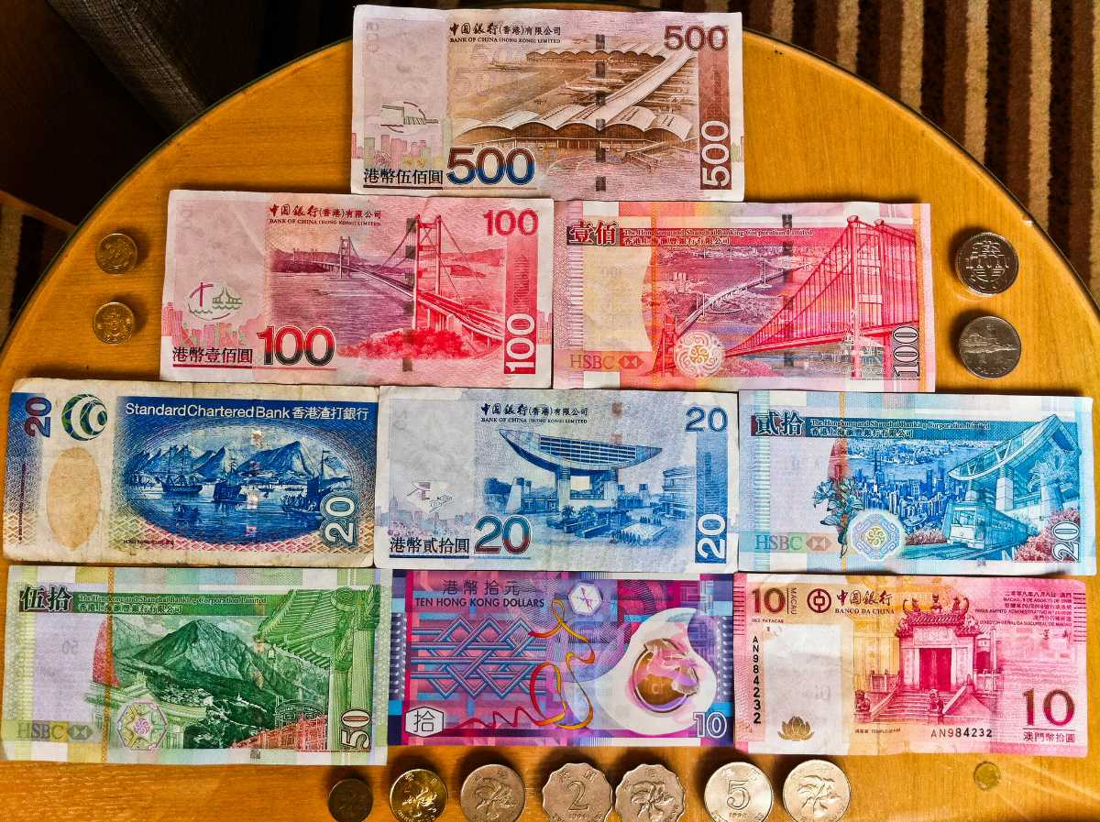
Hong Kong Dollar Currency
HKD

Slide 11
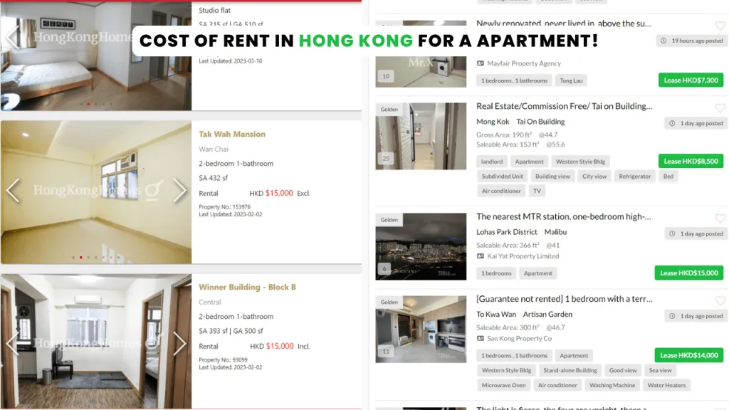
Depend on location(You must negotiate housing allowance from employer )

Slide 12
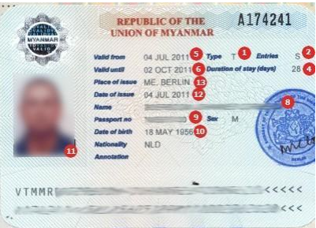
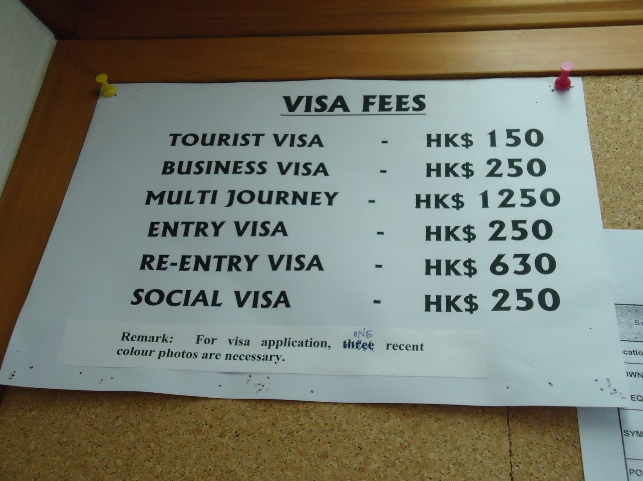
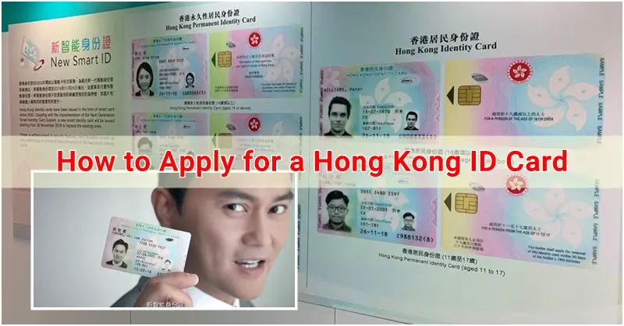

Slide 13
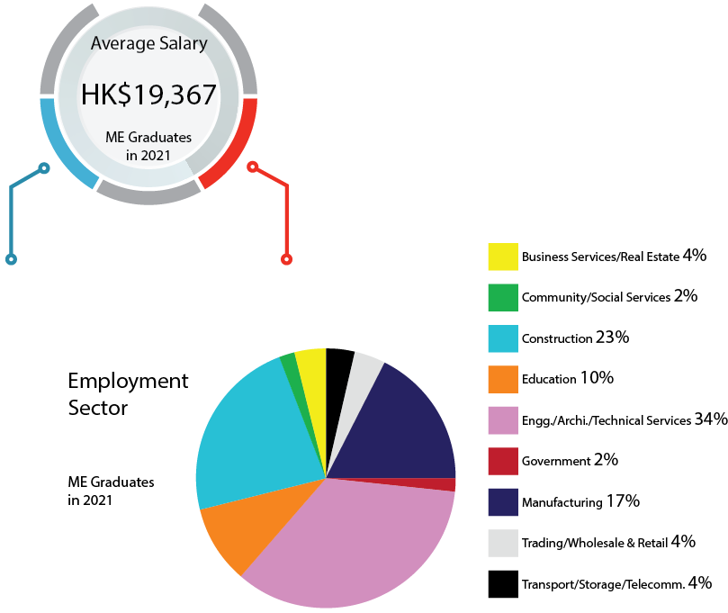

Slide 14
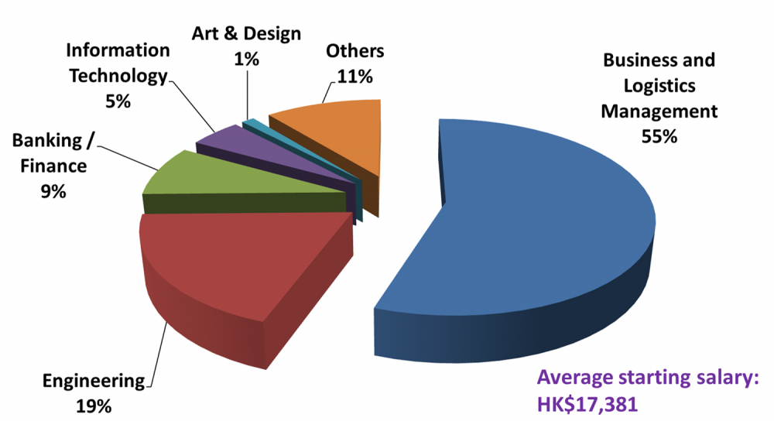

Slide 15


